Slide 1

Analysis of
Food and Beverage
Industry
Presented by- Divyanshi Yadav
For Mentorness
Under Batch MIP-DA-13

Slide 2

Contents
Introduction
Objectives
Project Overview
Dataset Overview
Analysis and Insights
Conclusion

Slide 3
Introduction
The food and beverage industry covers the full spectrum from production to retail, driven by growing global populations and rising incomes. Key trends include a shift toward healthier, organic products and increased focus on sustainability, with many companies adopting eco-friendly practices. Technological advancements, such as automation and e-commerce, are reshaping the sector.
Challenges like supply chain disruptions and intense competition persist, but opportunities remain in product innovation and expanding into new markets. Embracing digital sales channels further enhances growth potential. Overall, the industry is evolving rapidly with substantial prospects for adaptation and success.

Slide 4

Objectives
The Objective of this Power BI project is to analyze survey
responses from the food and beverage industry to gain insights into consumer behavior, preferences, and perceptions.
The analysis will help identify key trends, understand brand perception, and explore potential areas for improvement in product offerings and marketing strategies.

Slide 5

This Power BI project focuses on analyzing survey responses from the food and beverage industry to gain insights into consumer
Project Overview
behavior, preferences, and brand perceptions.
By examining data across different demographics, the project aims to identify key trends, understand consumer attitudes,
and pinpoint areas for improvement in products and marketing strategies.
The findings recommendations
will provide for refining
actionable product
offerings and marketing approaches. This will
enable businesses to better
align their expectations,
strategies enhance
with market
consumer
positioning, and drive
growth in the competitive food and beverage sector.

Slide 6
Fact Table: fact_survey_responses
Data Overview
Response_ID: Unique identifier for each survey response.
Respondent_ID: Unique identifier for each respondent.
Consume_frequency: Frequency of consumption of food and beverage products.
Consume_time: Typical time when the products are consumed.
Consume_reason: Reasonsfor consuming the products.
Heard_before: Whether the respondent has heard of the product before.
Brand_perception: Respondent's perception of the brand.
General_perception: Overall perception of the food and beverage industry.
Taste_experience: Respondent's experience with the taste of the product.
Reasons_preventing_trying: Reasons preventing respondentsfrom trying the product..
Continue..
Dimension Table: dim_respondent
Respondent_ID: Unique identifier for each respondent.
Name: Name of the respondent.
Age: Age of the respondent.
Gender: Gender of the respondent.
City_ID: Identifier linking the respondent to a city
Dimension Table: dim_cities
City_ID: Unique identifier for each city.
City: Name of the city.
Tier: Tier classification of the city (e.g., Tier 1, Tier 2).

Slide 7
Data Overview
Current_brands: Brands currently consumed by the respondent.
Reasons_for_choosing_brands: Reasonsfor choosing specific brands.
Improvements_desired: Improvements desired in products.
Ingredients_expected: Expected ingredients in products.
Health_concerns: Health concernsrelated to products.
Interest_in_natural_or_organic: Interest in natural or organic products.
Marketing_channels: Preferred marketing channels for product information.
Packaging_preference: Preferencesfor product packaging
Limited_edition_packaging: Interest in limited edition packaging.
Price_range: Preferred price range for products.
Purchase_location: Typical locations where products are purchased.
Typical_consumption_situations: Common situationsin which products are

Slide 8
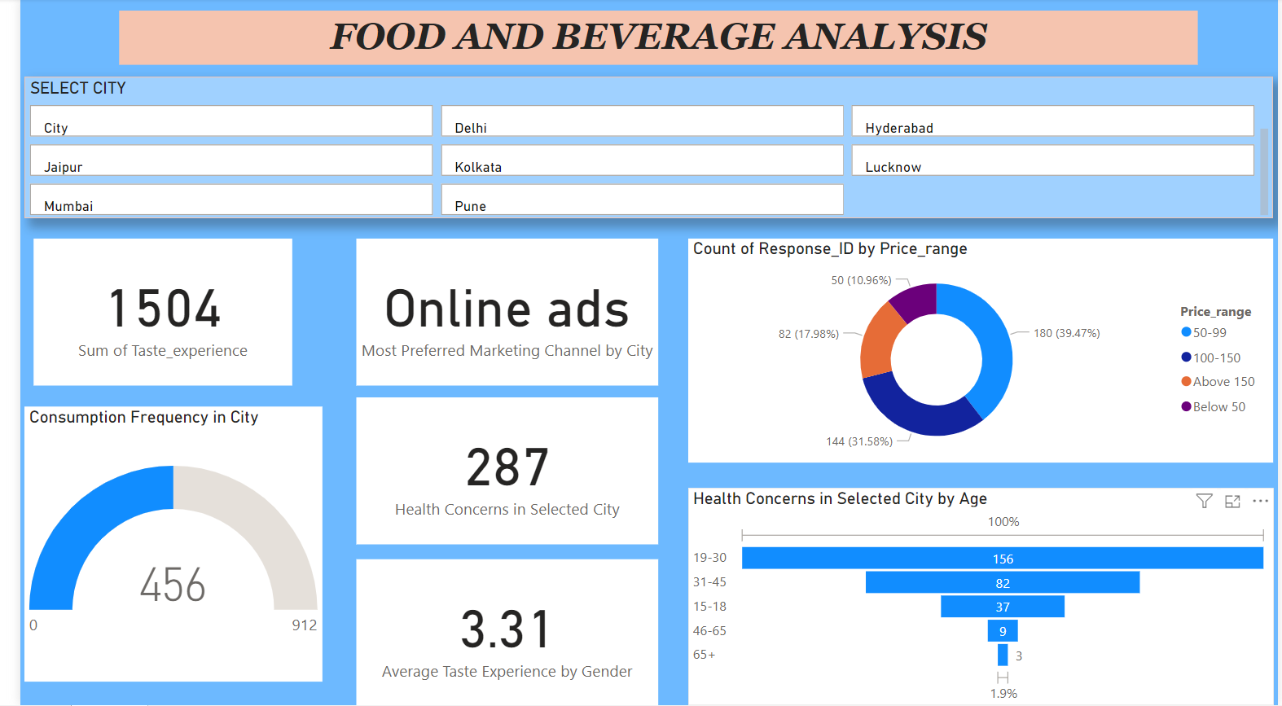
Analysis and Insights

Slide 9
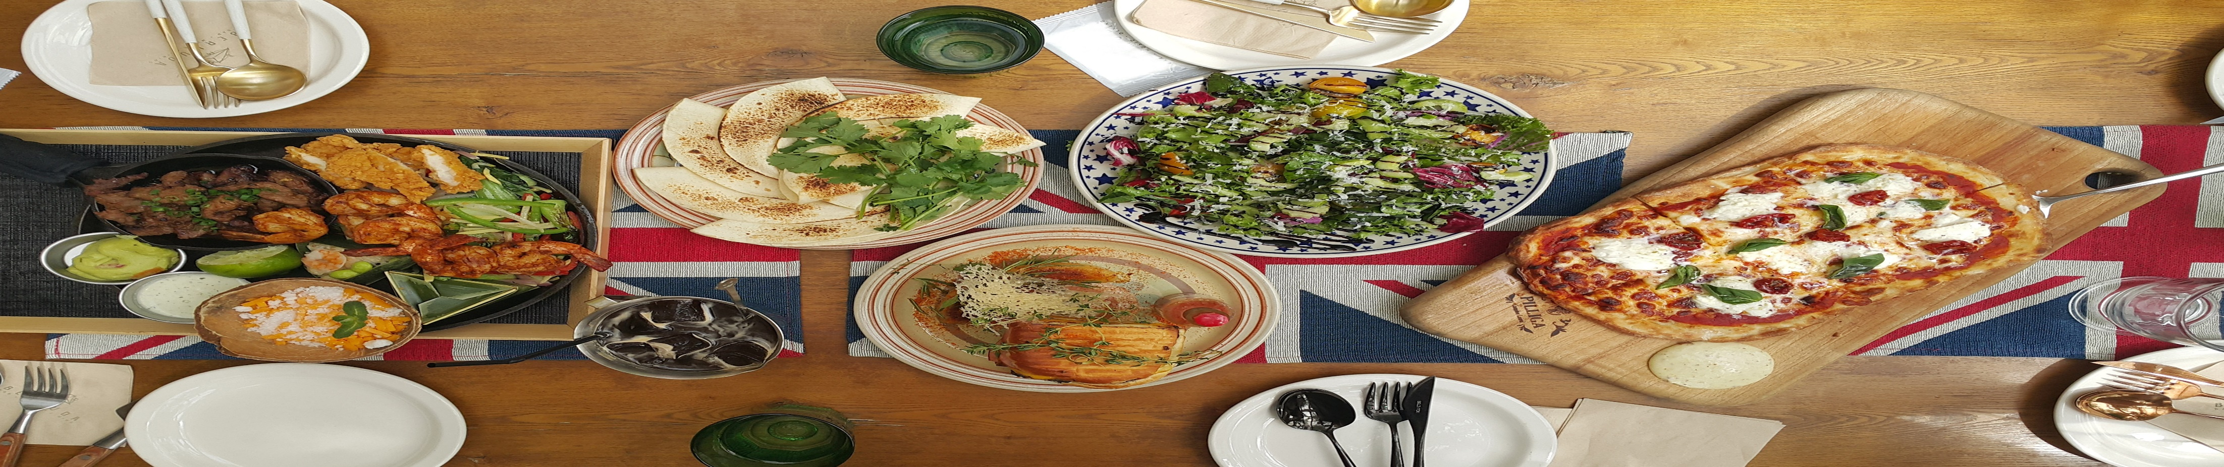
Conclusion
The analysis of survey data from the food and beverage industry has provided valuable insights into consumer behavior, preferences, and brand perceptions. By identifying key trends and understanding consumer attitudes, the project has highlighted areas where product offerings and marketing strategies can be enhanced. The actionable recommendations derived from this analysis will help businesses align more closely with consumer needs, optimize their market strategies, and improve overall customer satisfaction.
Ultimately, this project equips industry stakeholders with the knowledge to make informed decisions, drive strategic improvements, and strengthen their competitive position in the market.

